Slide 1
PARAMETRIC DESIGN OF SHOE MIDSOLES USING LATTICE STRUCTURES
DESN3002 Final Project Proposal
Gladys Chan

Slide 2
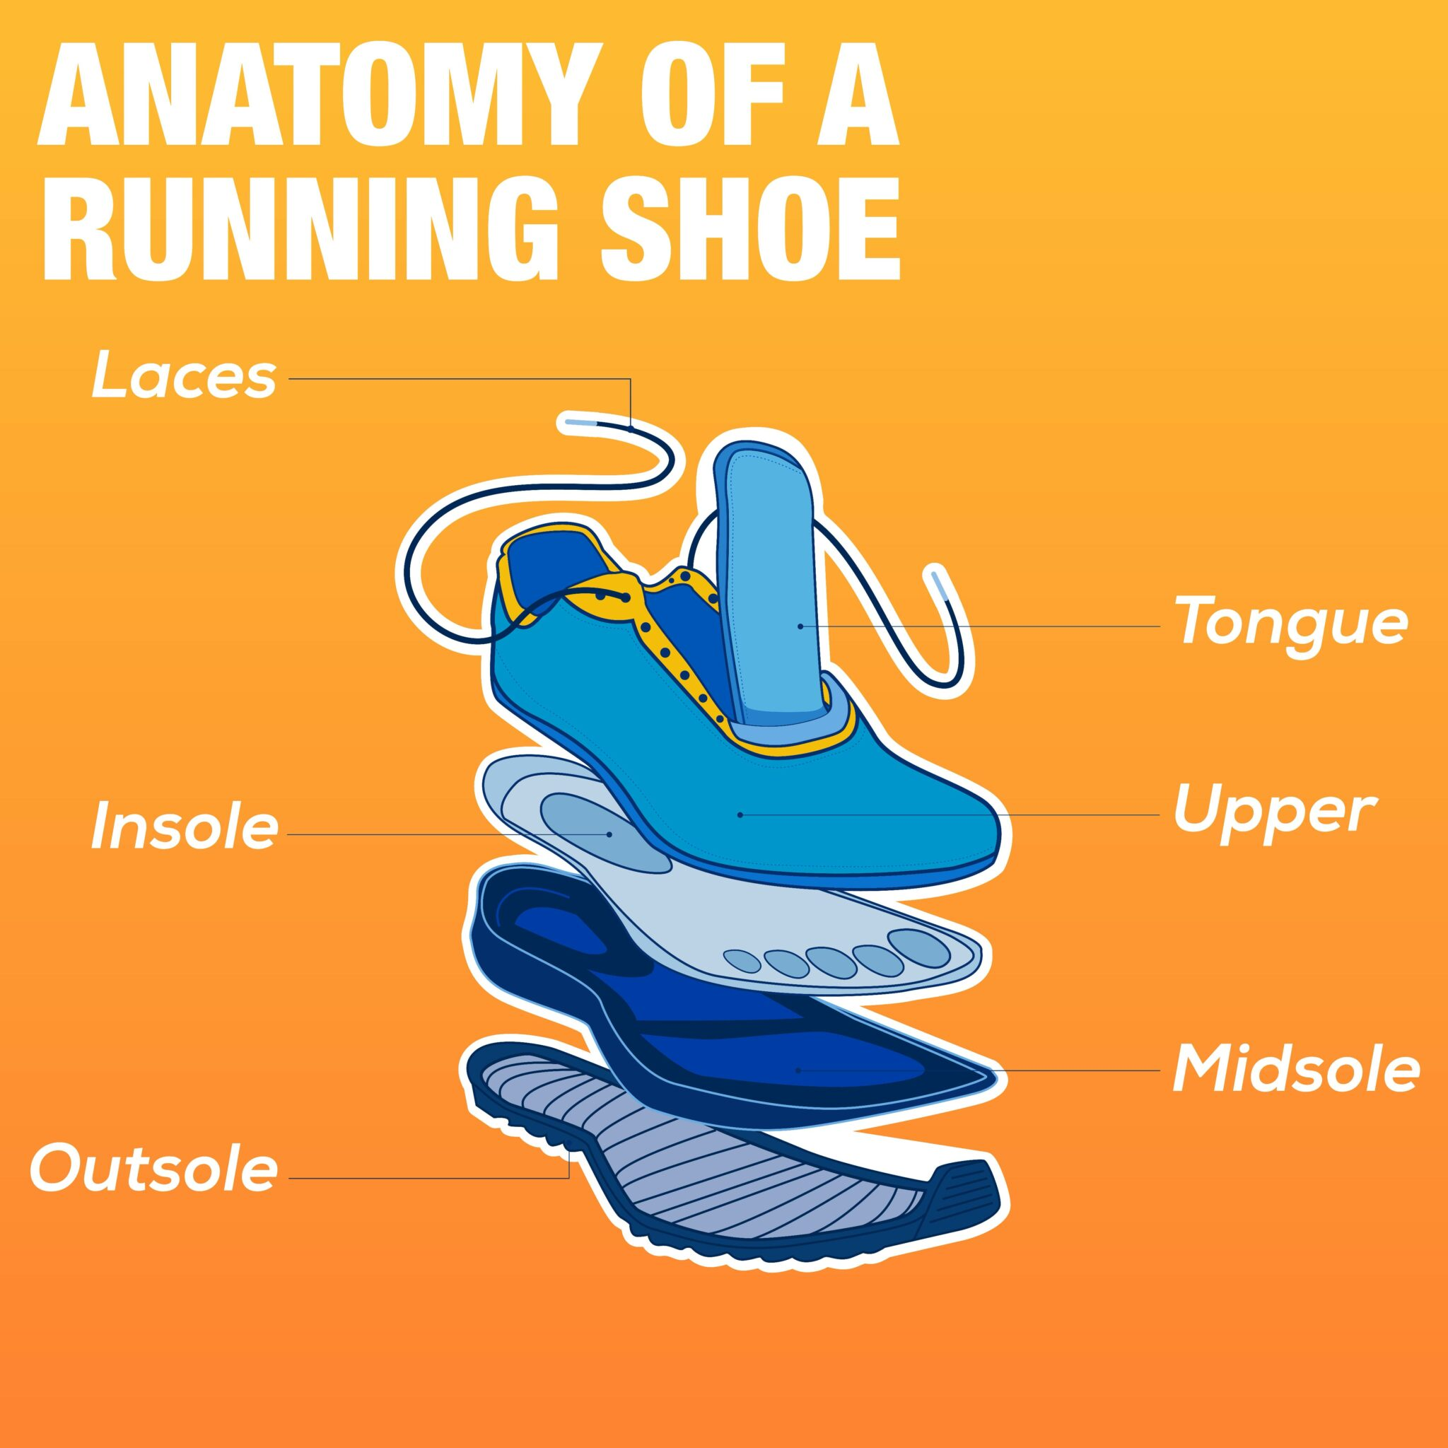
Significance of Shoe Soles
(Ribarits)

Slide 3
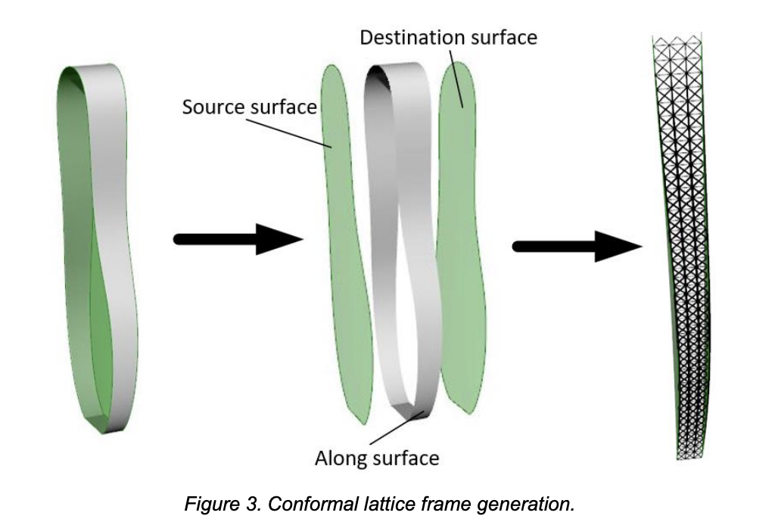
Focusing on Designing the Midsole
Conformal Lattice Frame Generation
Shoe Midsole
(Dong et al. 722)

Slide 4
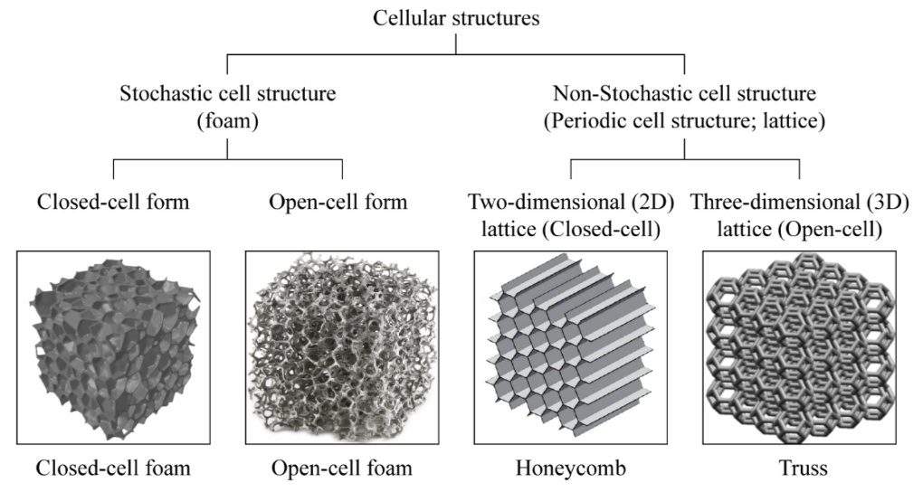
Why Lattice Structures?
Categories of Cellular Structures
Advantages of lattice structures
high specific strength and stiffness
ultra-low weight
good ability of their internal structures to absorb an external impact force
(Park et al. 2)

Slide 5
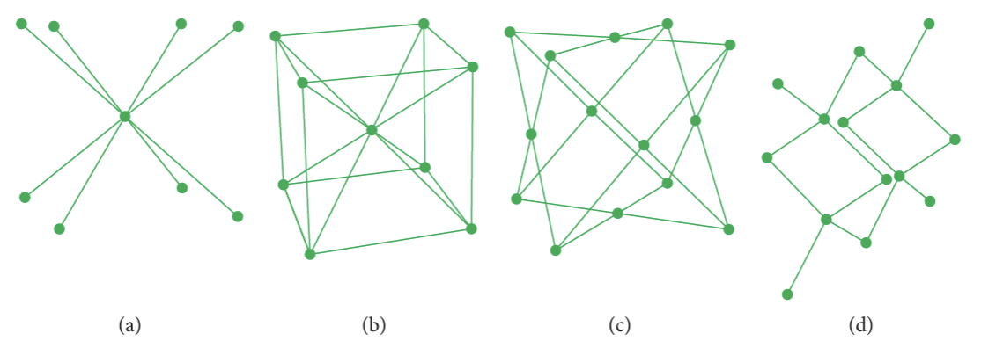
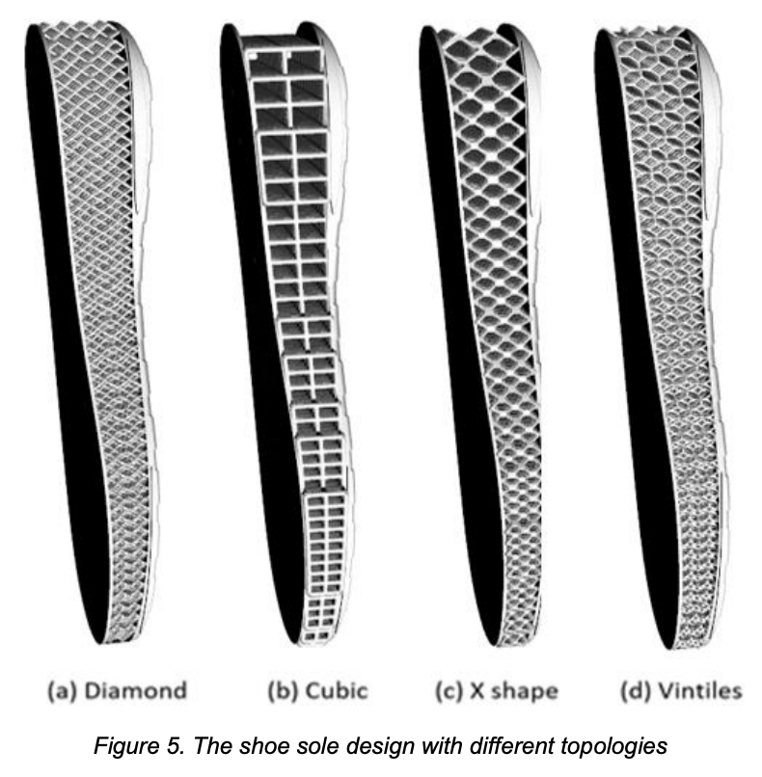
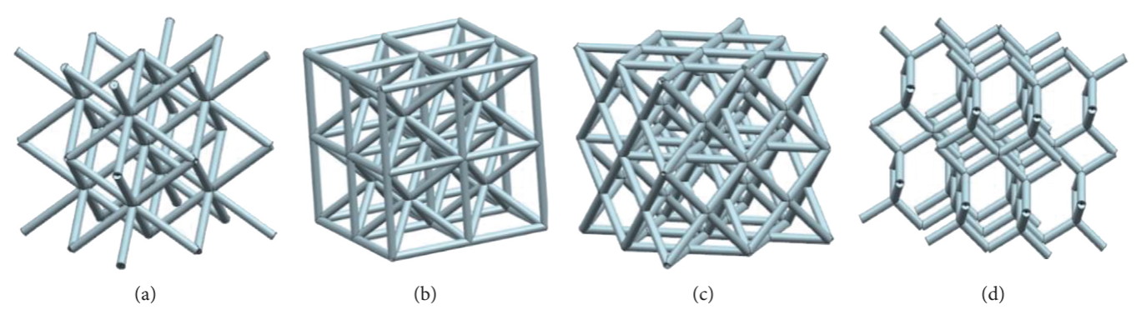
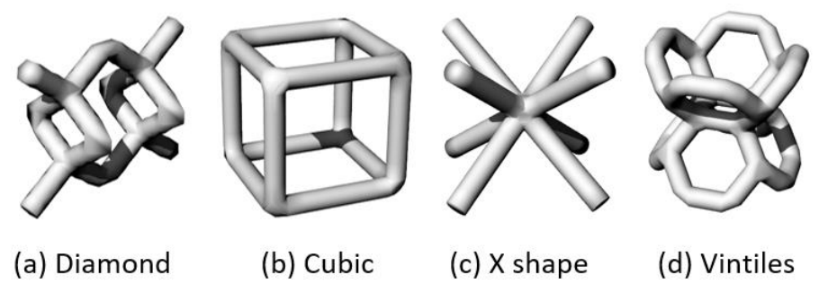
Topologies for Lattice Structure
Examples of Topologies/Unit Cell Types for Lattice Structure
Shoe Sole Design Examples with Different Topologies
(Liu et al. 4)
(Dong et al. 723)
(Dong et al. 722)

Slide 6
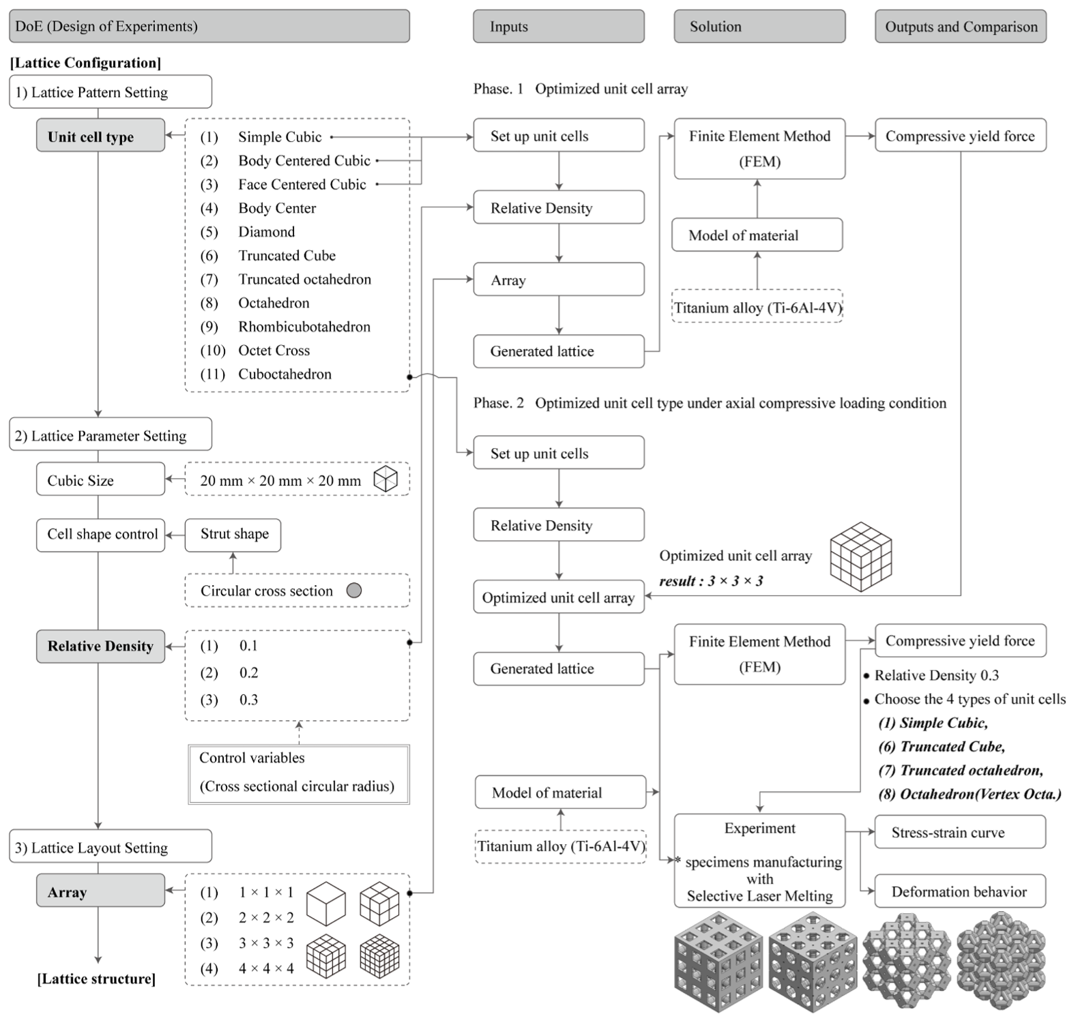
Lattice Configuration Optimization Method
(Park et al. 4)

Slide 7
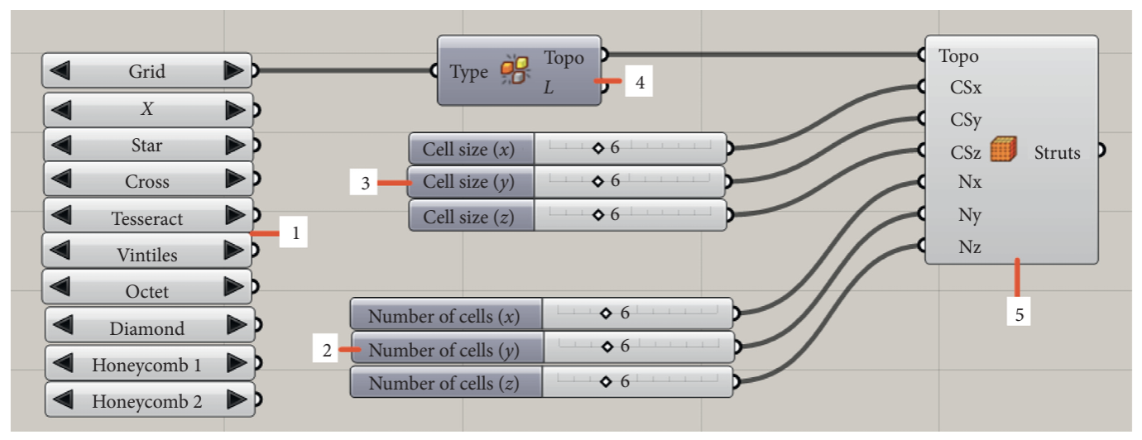
Modelling Lattice Structure in Grasshopper
Example of Lattice Wireframe Battery Generation Graph
Variables:
Cell size
Number of cells
Types of unit cell structures
(Liu et al. 4)

Slide 8
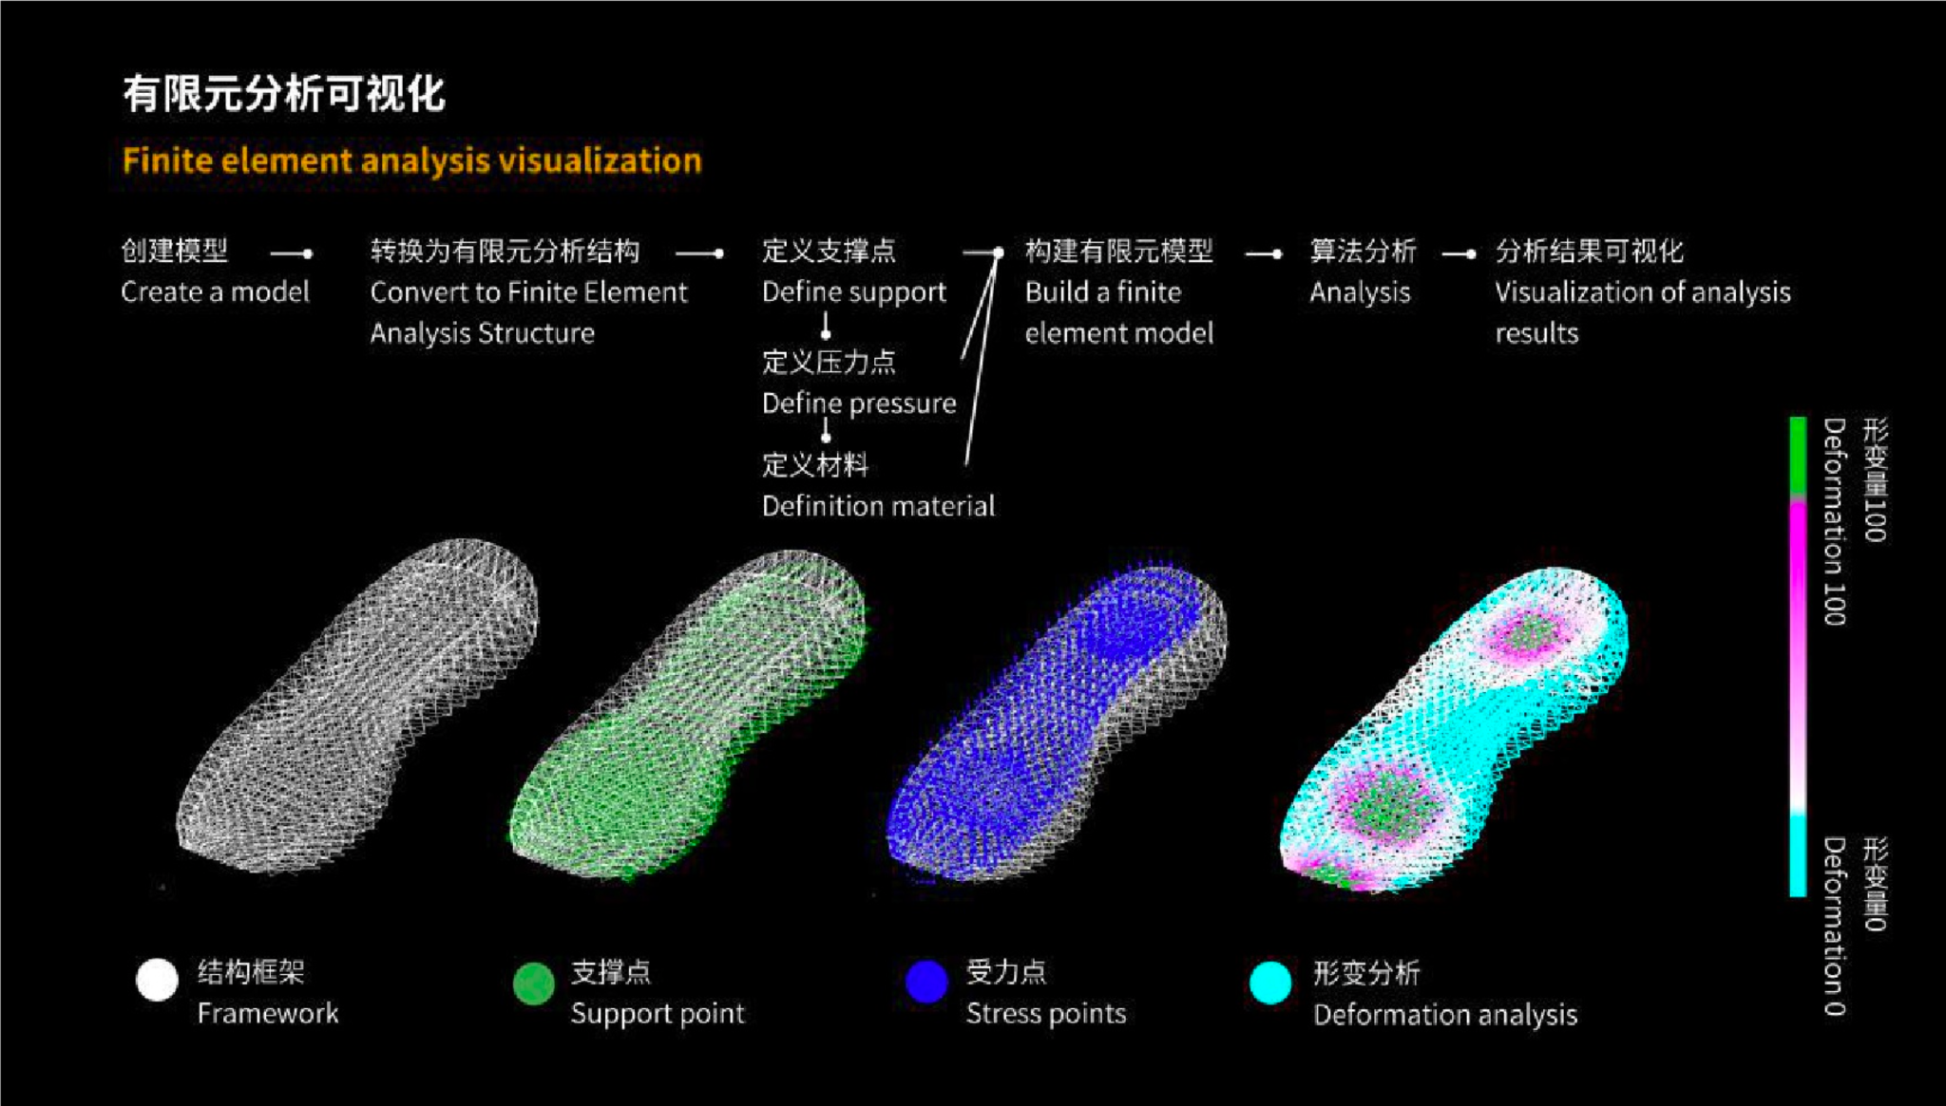
Finite Element Analysis using Karamba (1)
Example of Finite Element Analysis of Shoe Sole with Lattice Structure
Using the FEA component of Karamba in Grasshopper
(Cui 52)

Slide 9
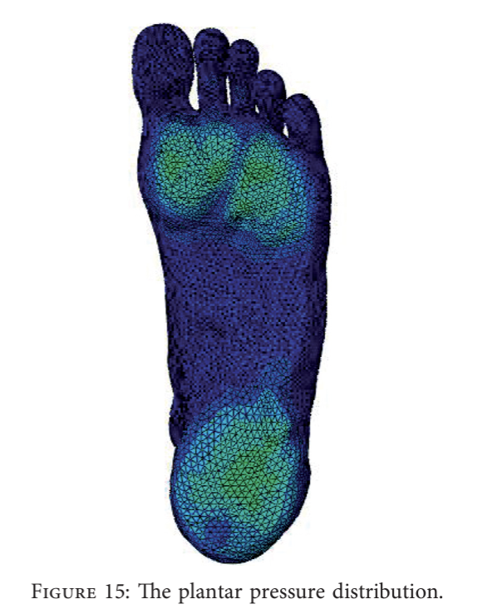
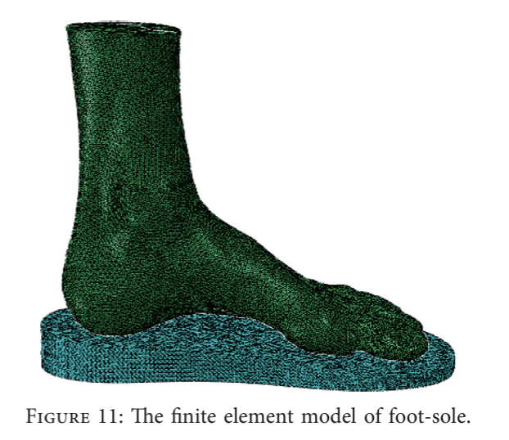
Finite Element Analysis using ABAQUS (2)
The Finite Element Model of Foot-Sole
The Plantar Pressure Distribution
(Liu et al. 7, 9)

Slide 10

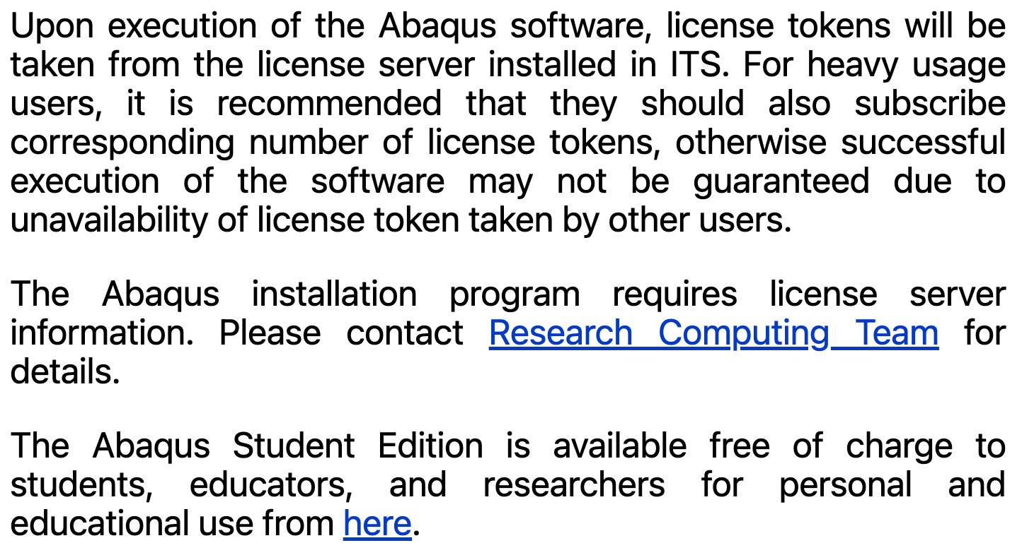
Access to ABAQUS

Slide 11
Pipeline
Define Parameters
Data Analysis
Explore Lattice Topologies
Build Parametric Model
Finite Element Analysis
Optimization of Model
Final Model
iterations

Slide 12
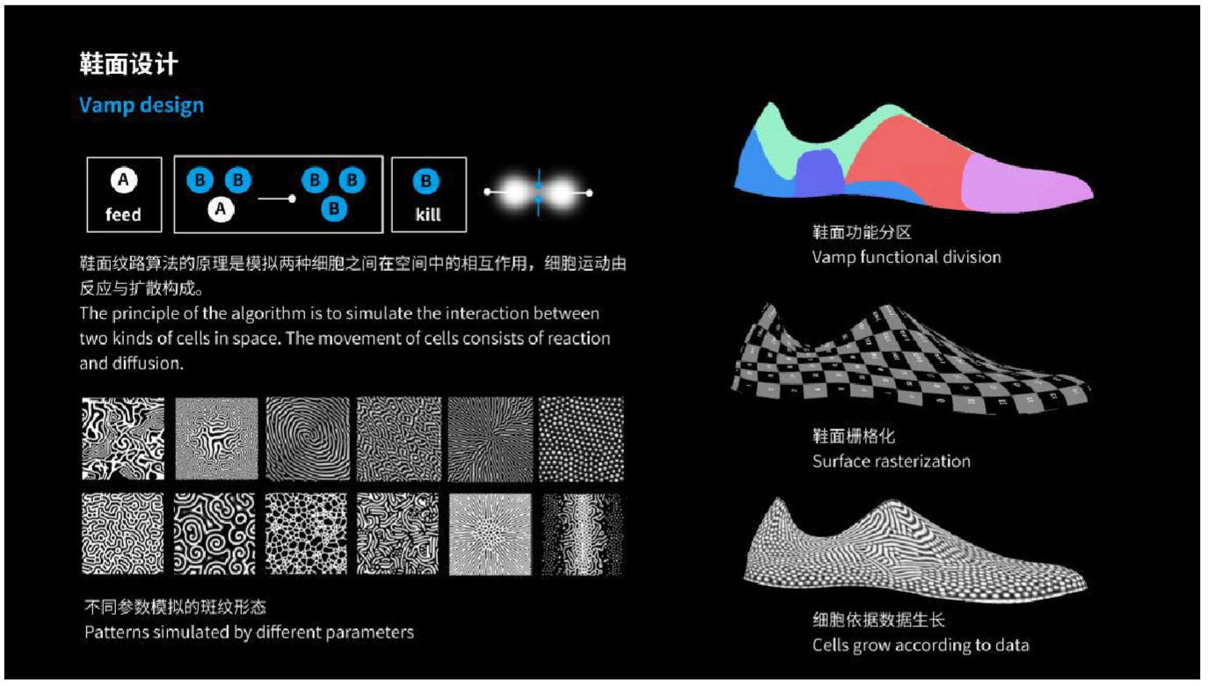
Additional Machine Learning for Shoe Surface
(Cui 51)

Slide 13
Works Cited
Dong, Guoying, Daniel Tessier, and Yaoyao Fiona Zhao. “Design of Shoe Soles Using Lattice Structures Fabricated by Additive Manufacturing.” Proceedings of the Design Society: International Conference on Engineering Design 1.1 (2019): 719–728. Web.
Liu, Xiaoying, et al. “Finite Element Analysis of Shock Absorption of Porous Soles Established by Grasshopper and UG Secondary Development.” Mathematical Problems in Engineering, vol. 2020, 18 Nov. 2020, pp. 1–12, doi:10.1155/2020/2652137.
Park, Kwang-Min, et al. “Design Optimization of Lattice Structures under Compression: Study of Unit Cell Types and Cell Arrangements.” Materials, vol. 15, no. 1, 23 Dec. 2021, p. 97, doi:10.3390/ma15010097.
Ribarits, Jaqlyn. “The Anatomy of a Running Shoe: Maximize Your Running Experience and Unleash Your Full Potential.” Sun & Ski Sports, 14 Apr. 2023, www.sunandski.com/. Accessed 14 Mar. 2024.
Tang, Yunlong, et al. “Data-Driven Design of Customized Porous Lattice Sole Fabricated by Additive Manufacturing.” Procedia Manufacturing, vol. 53, 2021, pp. 318–326, doi:10.1016/j.promfg.2021.06.035.
Qiang, Cui. Research on the Application of Parametric Design in Industrial Product Design. 2018. Beijing University of Technology. Master’s Thesis.

